Slide 1
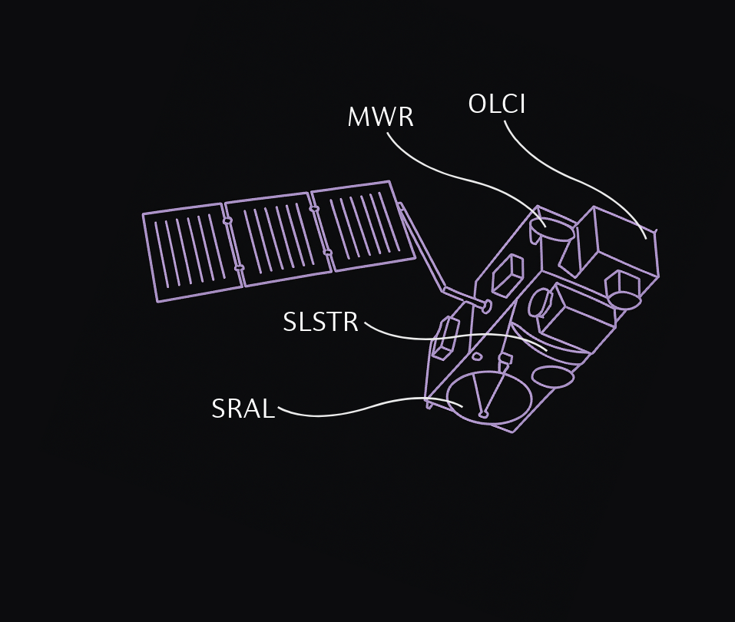
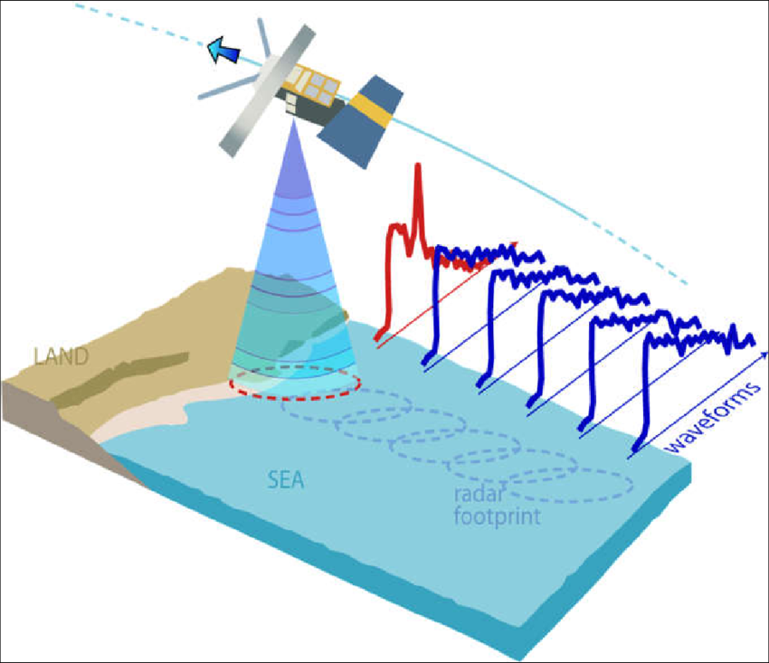
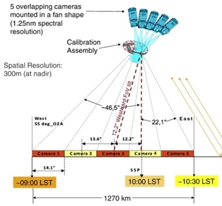
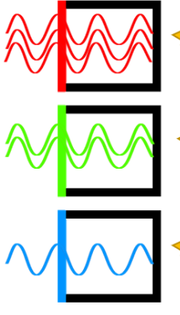
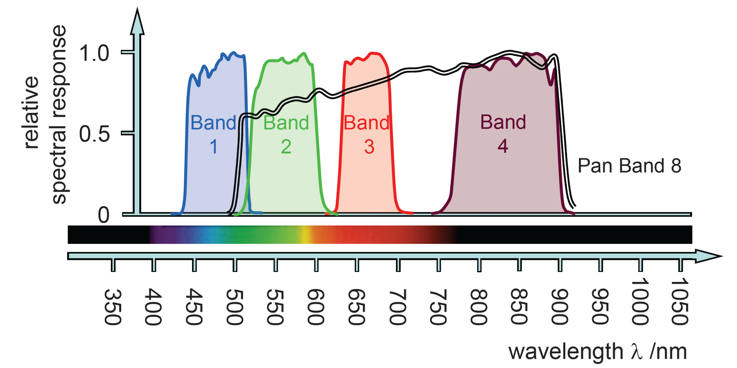
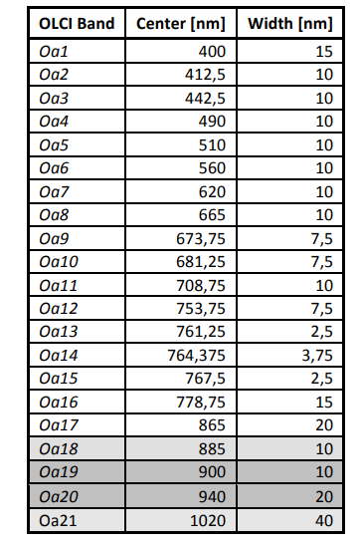
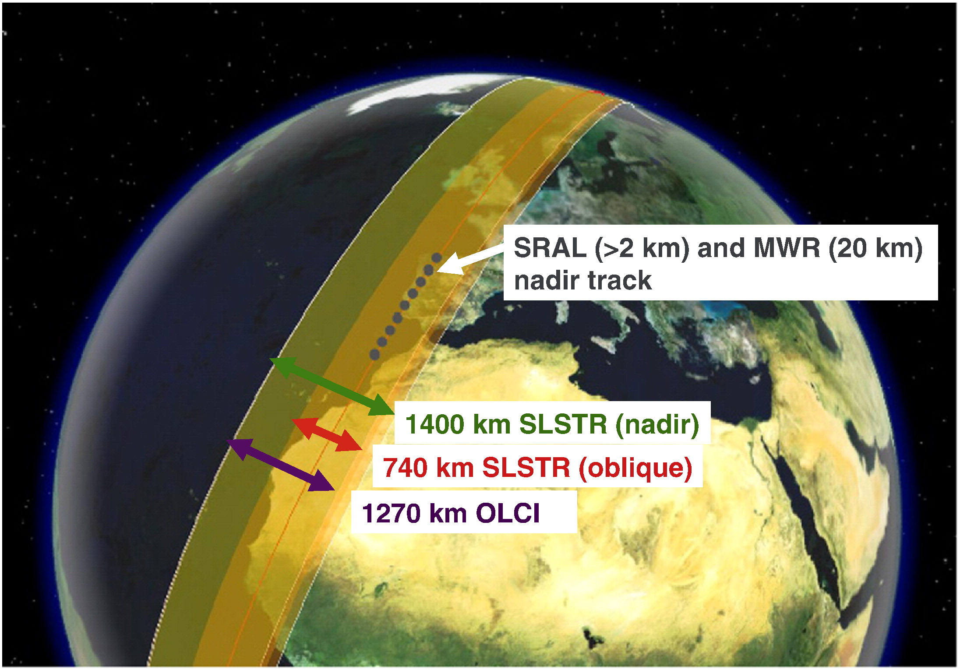
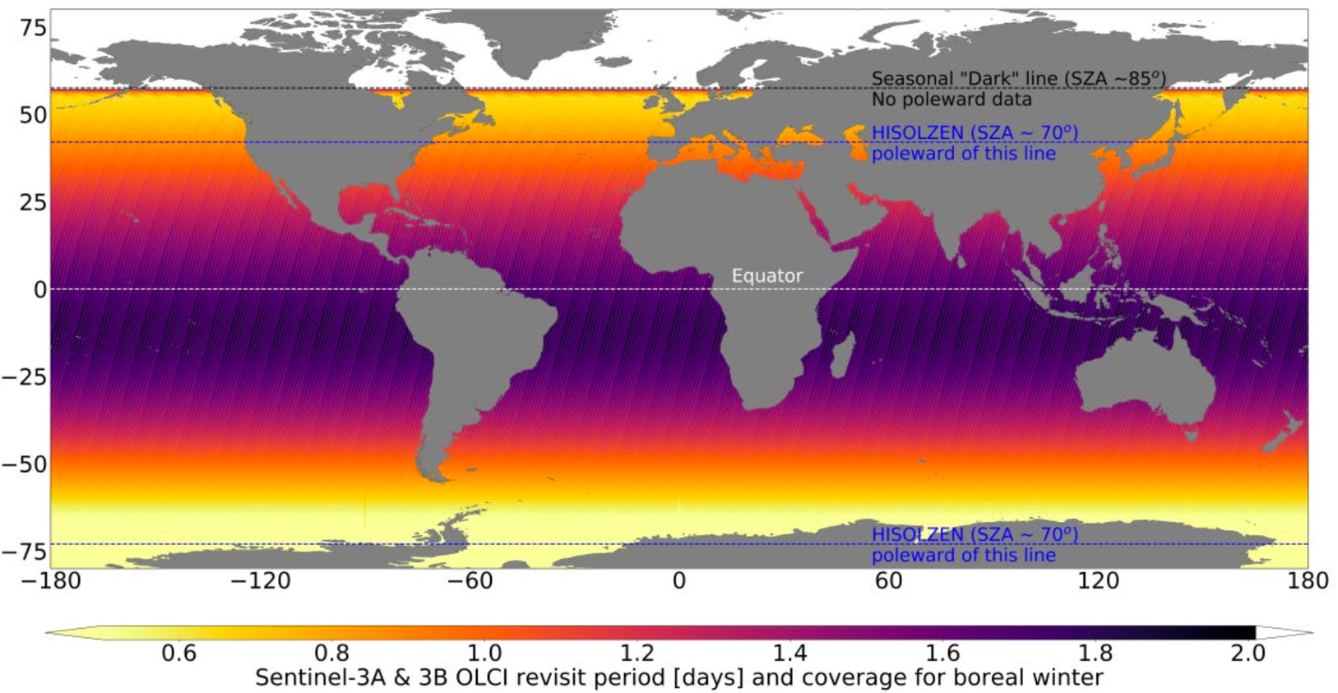
Detector
Photosensitive substrate
Filter
Tilted filed of view to avoid sun glint
Photon energy split across 21 spectral bands
B: Modification of the shape waveforms (in red) when a satellite altimeter approaches the coast entering the radar footprint, making the estimate of range and other derived quantities more difficult. [Credits: COASTALT]
C: Basic geometry of the OLCI, showing the fan arrangement of the five cameras that will view Earth through the calibration assembly and the off-nadir pointing of the instrument swath. The Observation Zenith Angle (OZA) is limited to a maximum of 55°. The swath is 1 270 km. The Local Solar Time (LST) of observations is indicated in the lower part of the figure.
D. The Sentinel-3 OLCI instrument measures reflected sunlight across 21 spectral bands, including visible and near-infrared, to monitor Earth's surface. [Credits: EUMETSAT]
A. Copernicus Sentinel 3 satellite
Altimetry
Increasing imagery detail and complexity
SSH/Geoid
Gravity Anomalies
Bathymetry
E. Band characteristics of the SENTINEL 3 Ocean and Land Cover Instrument (OLCI) [Credits: ESA]
F: Sentinel-3 Ground Track Resolution [Credits: ESA]
G: Average OLCI revisit time for two satellites during the boreal winter period, the 27-day cycle centered on 21 December [Credits: EUMETSAT]
H: Sequence of extracting geophysical information from altimetry. Credit: University of Calgary

